Slide 1
Panic and the Great Recession --Evidence from Commercial and Financial Chronicle (CFC 1868-1910)
Dingqian Liu

Slide 2
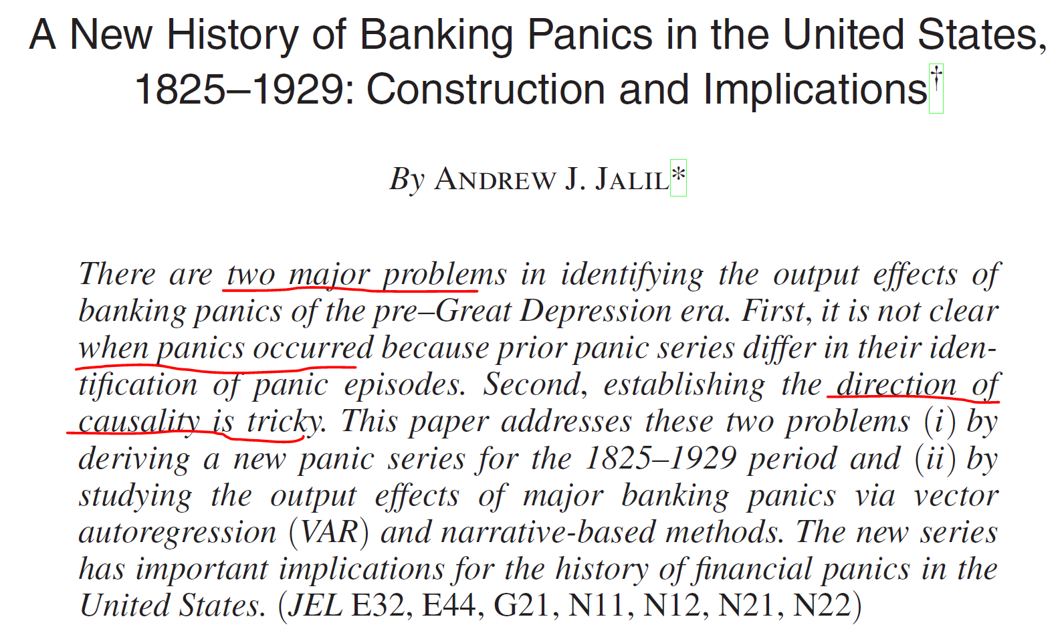

Slide 3
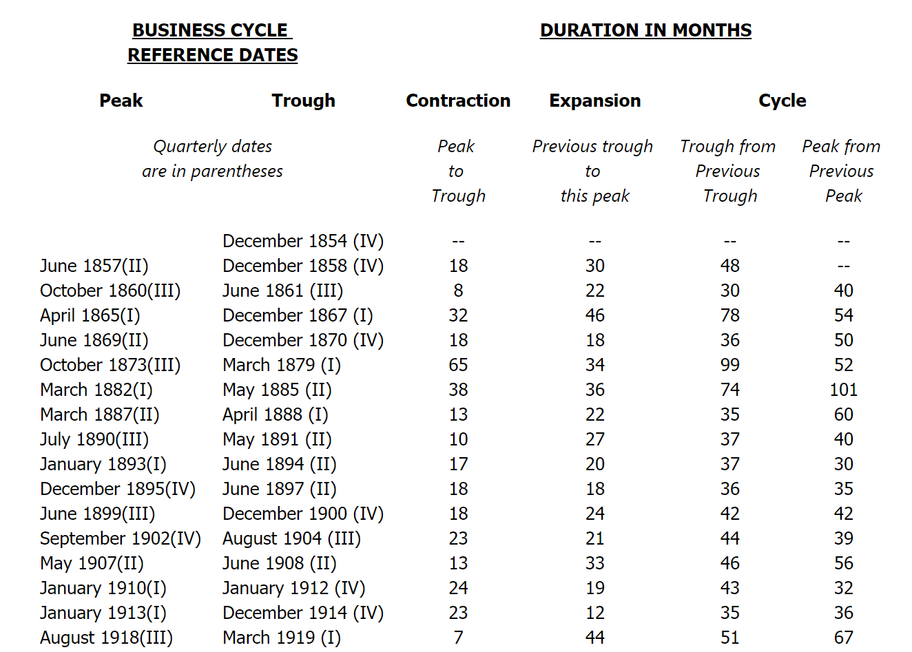
Source:
NBER website

Slide 4
Commercial and Financial Chronicle
A weekly newspaper representing the industrial and commercial interests of the United States.
Data from the publication is, however, used by many economic historians, as it is one of the few sources available
Douglas Steeples, Dana's biographer, wrote that "one can scarcely reconstruct the business history of the United States between the Civil War and 1910 without immersing oneself in his paper. Even the most important series of business statistics published by the U.S. government, Historical Statistics of the United States [...], depends heavily on his work and that of the correspondents worldwide who contributed to the Chronicle." The publication (little known or noticed at the time of its demise) ceased publication during the fall out of Black Monday and the stock market troubles of 1987.

Slide 5
Literature
Jalil, A.J., 2015. A new history of banking panics in the United States, 1825-1929: construction and implications. American Economic Journal: Macroeconomics, 7(3), pp.295-330.
Use Index pages instead of weekly newspapers: 2 index files per year
“provide detailed lists of specific information found in each volume”
Weekly newspapers: over 40 pages
In total over 8000 weekly newspapers 1868-1965
Over 3200 weekly newspapers 1868-1910

Slide 6
Search Terms
bank failure, bank suspension, bank run, bank closure, bank crisis, bank panic, bank disturbance
financial crisis, financial disturbance, financial revulsion
suspension of payments, suspension of specie payments
crash, crisis, panic, revulsion, run, suspension

Slide 7
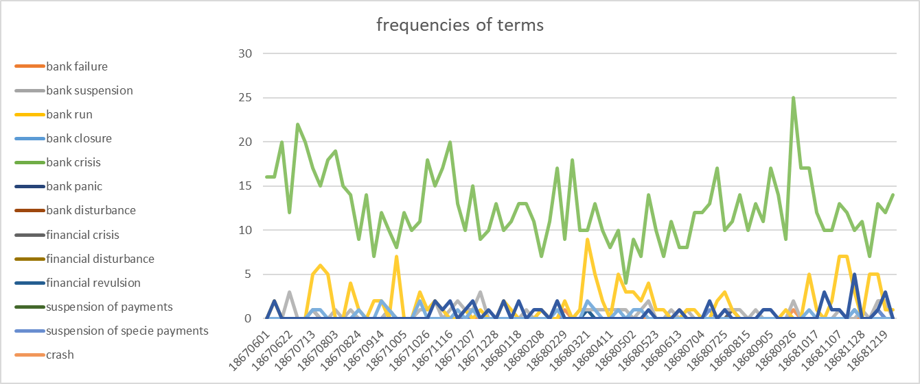

Slide 8
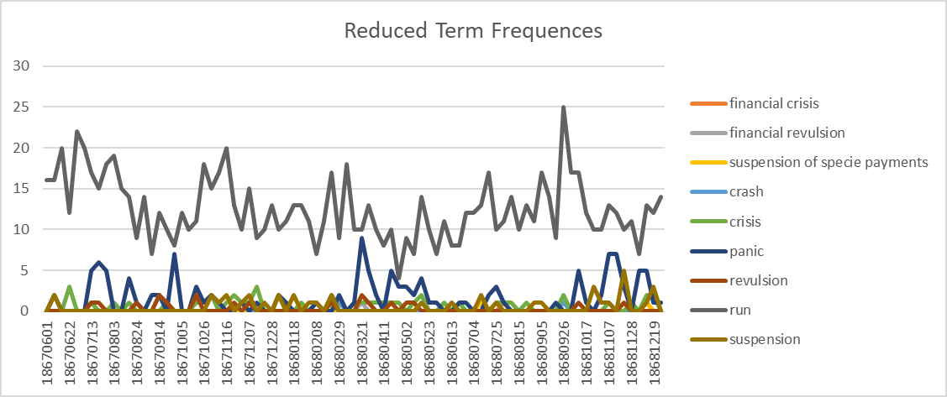

Slide 9
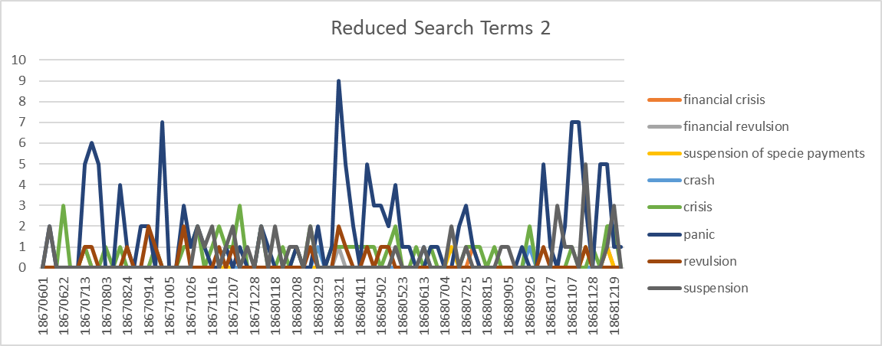

Slide 10
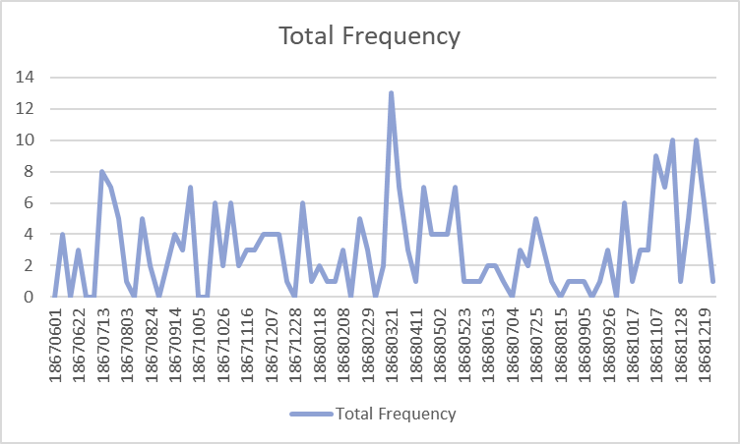

Slide 11
To Do
Extend the time till 1910 at least
Add annotation
Normalize the index, maybe by page
Compare the results with Jalil’s work
Sentiment analysis with sentiment dictionaries: NRC, Bing, AFINN, Loughran
Püttmann, Lukas. "Patterns of Panic: Financial Crisis Language in Historical Newspapers." (2018).

Slide 12
Sentiment Dictionaries
The NRC (National Research Council Canada) dictionary by Mohammad and Turney (2010) and Mohammad and Turney (2013) is not specific to any domain but is meant to be quite general
The Bing lexicon by Hu and Liu (2004) and Liu et al. (2005) serves primarily to evaluate customer reviews.
Nielsen (2011) constructs the AFINN (Affective Norms for English Words) with the purpose of measuring language on microblogs and tweets.
The dictionary by Loughran and McDonald (2011) is the one most tailored to measuring emotional connotations in business reports, press briefings and has also been previously applied to the financial press (e.g. by Garc´ıa, 2013). Only AFINN assigns scores from -5 to +5 to words and the other three dictionaries sort words into simple “positive” and “negative” categories.

